Slide 7
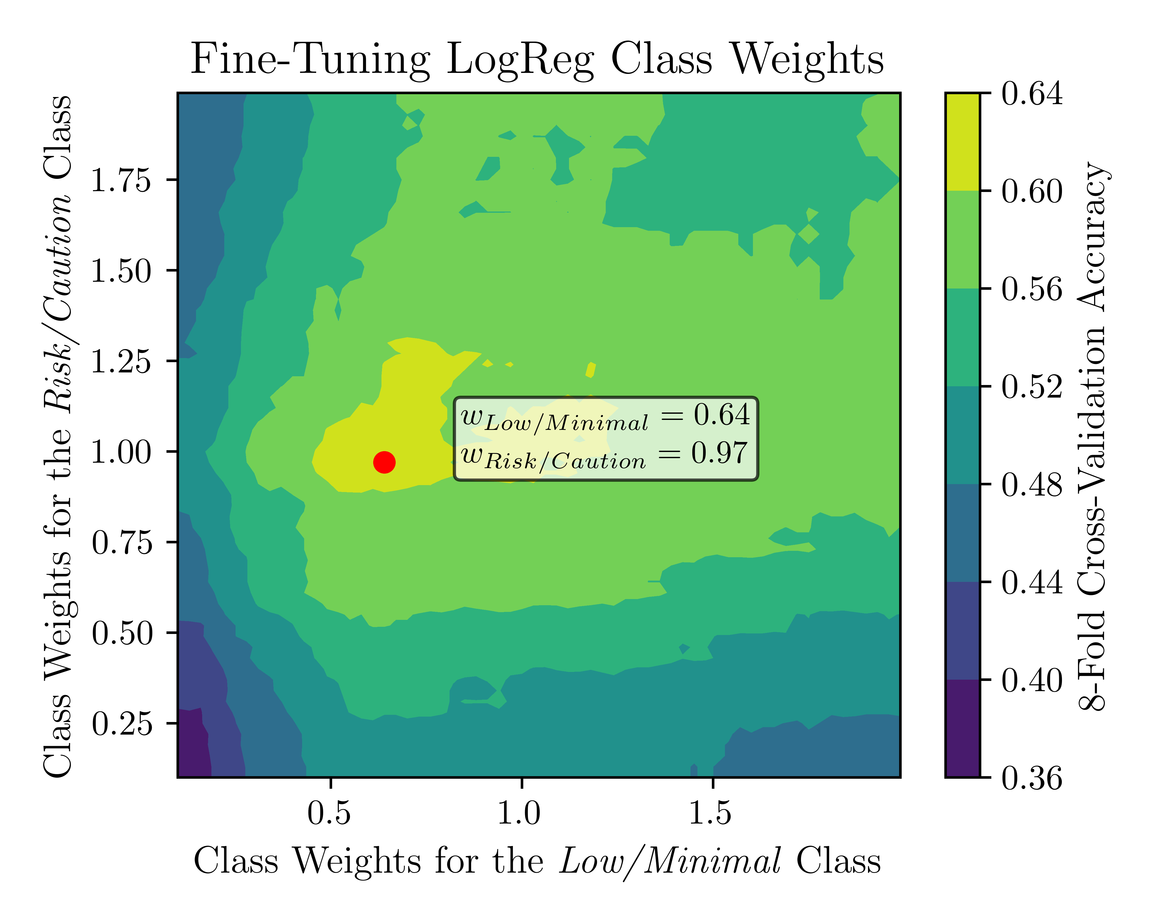
LOGISTIC REGRESSION
Hyperameter space table

Slide 8
LOGISTIC REGRESSION

Slide 9
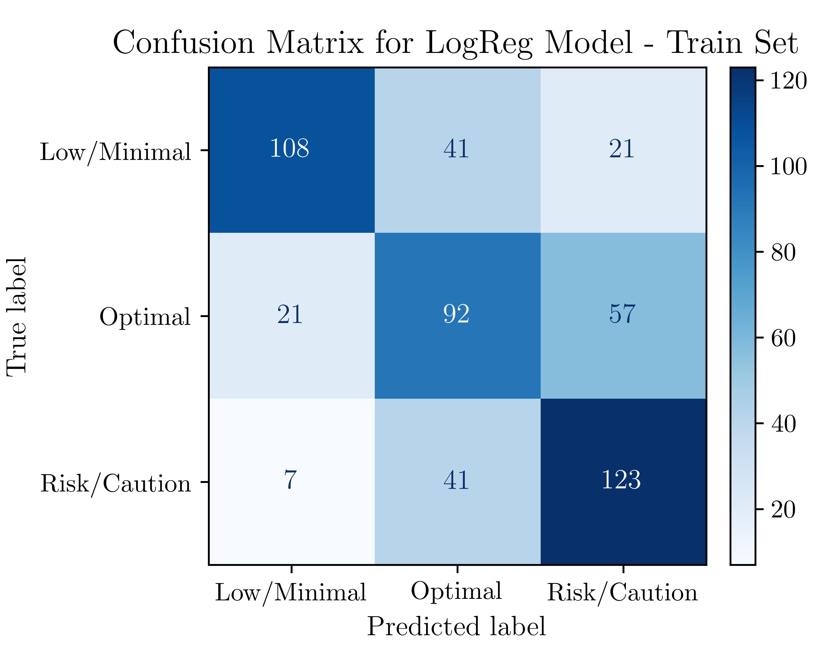
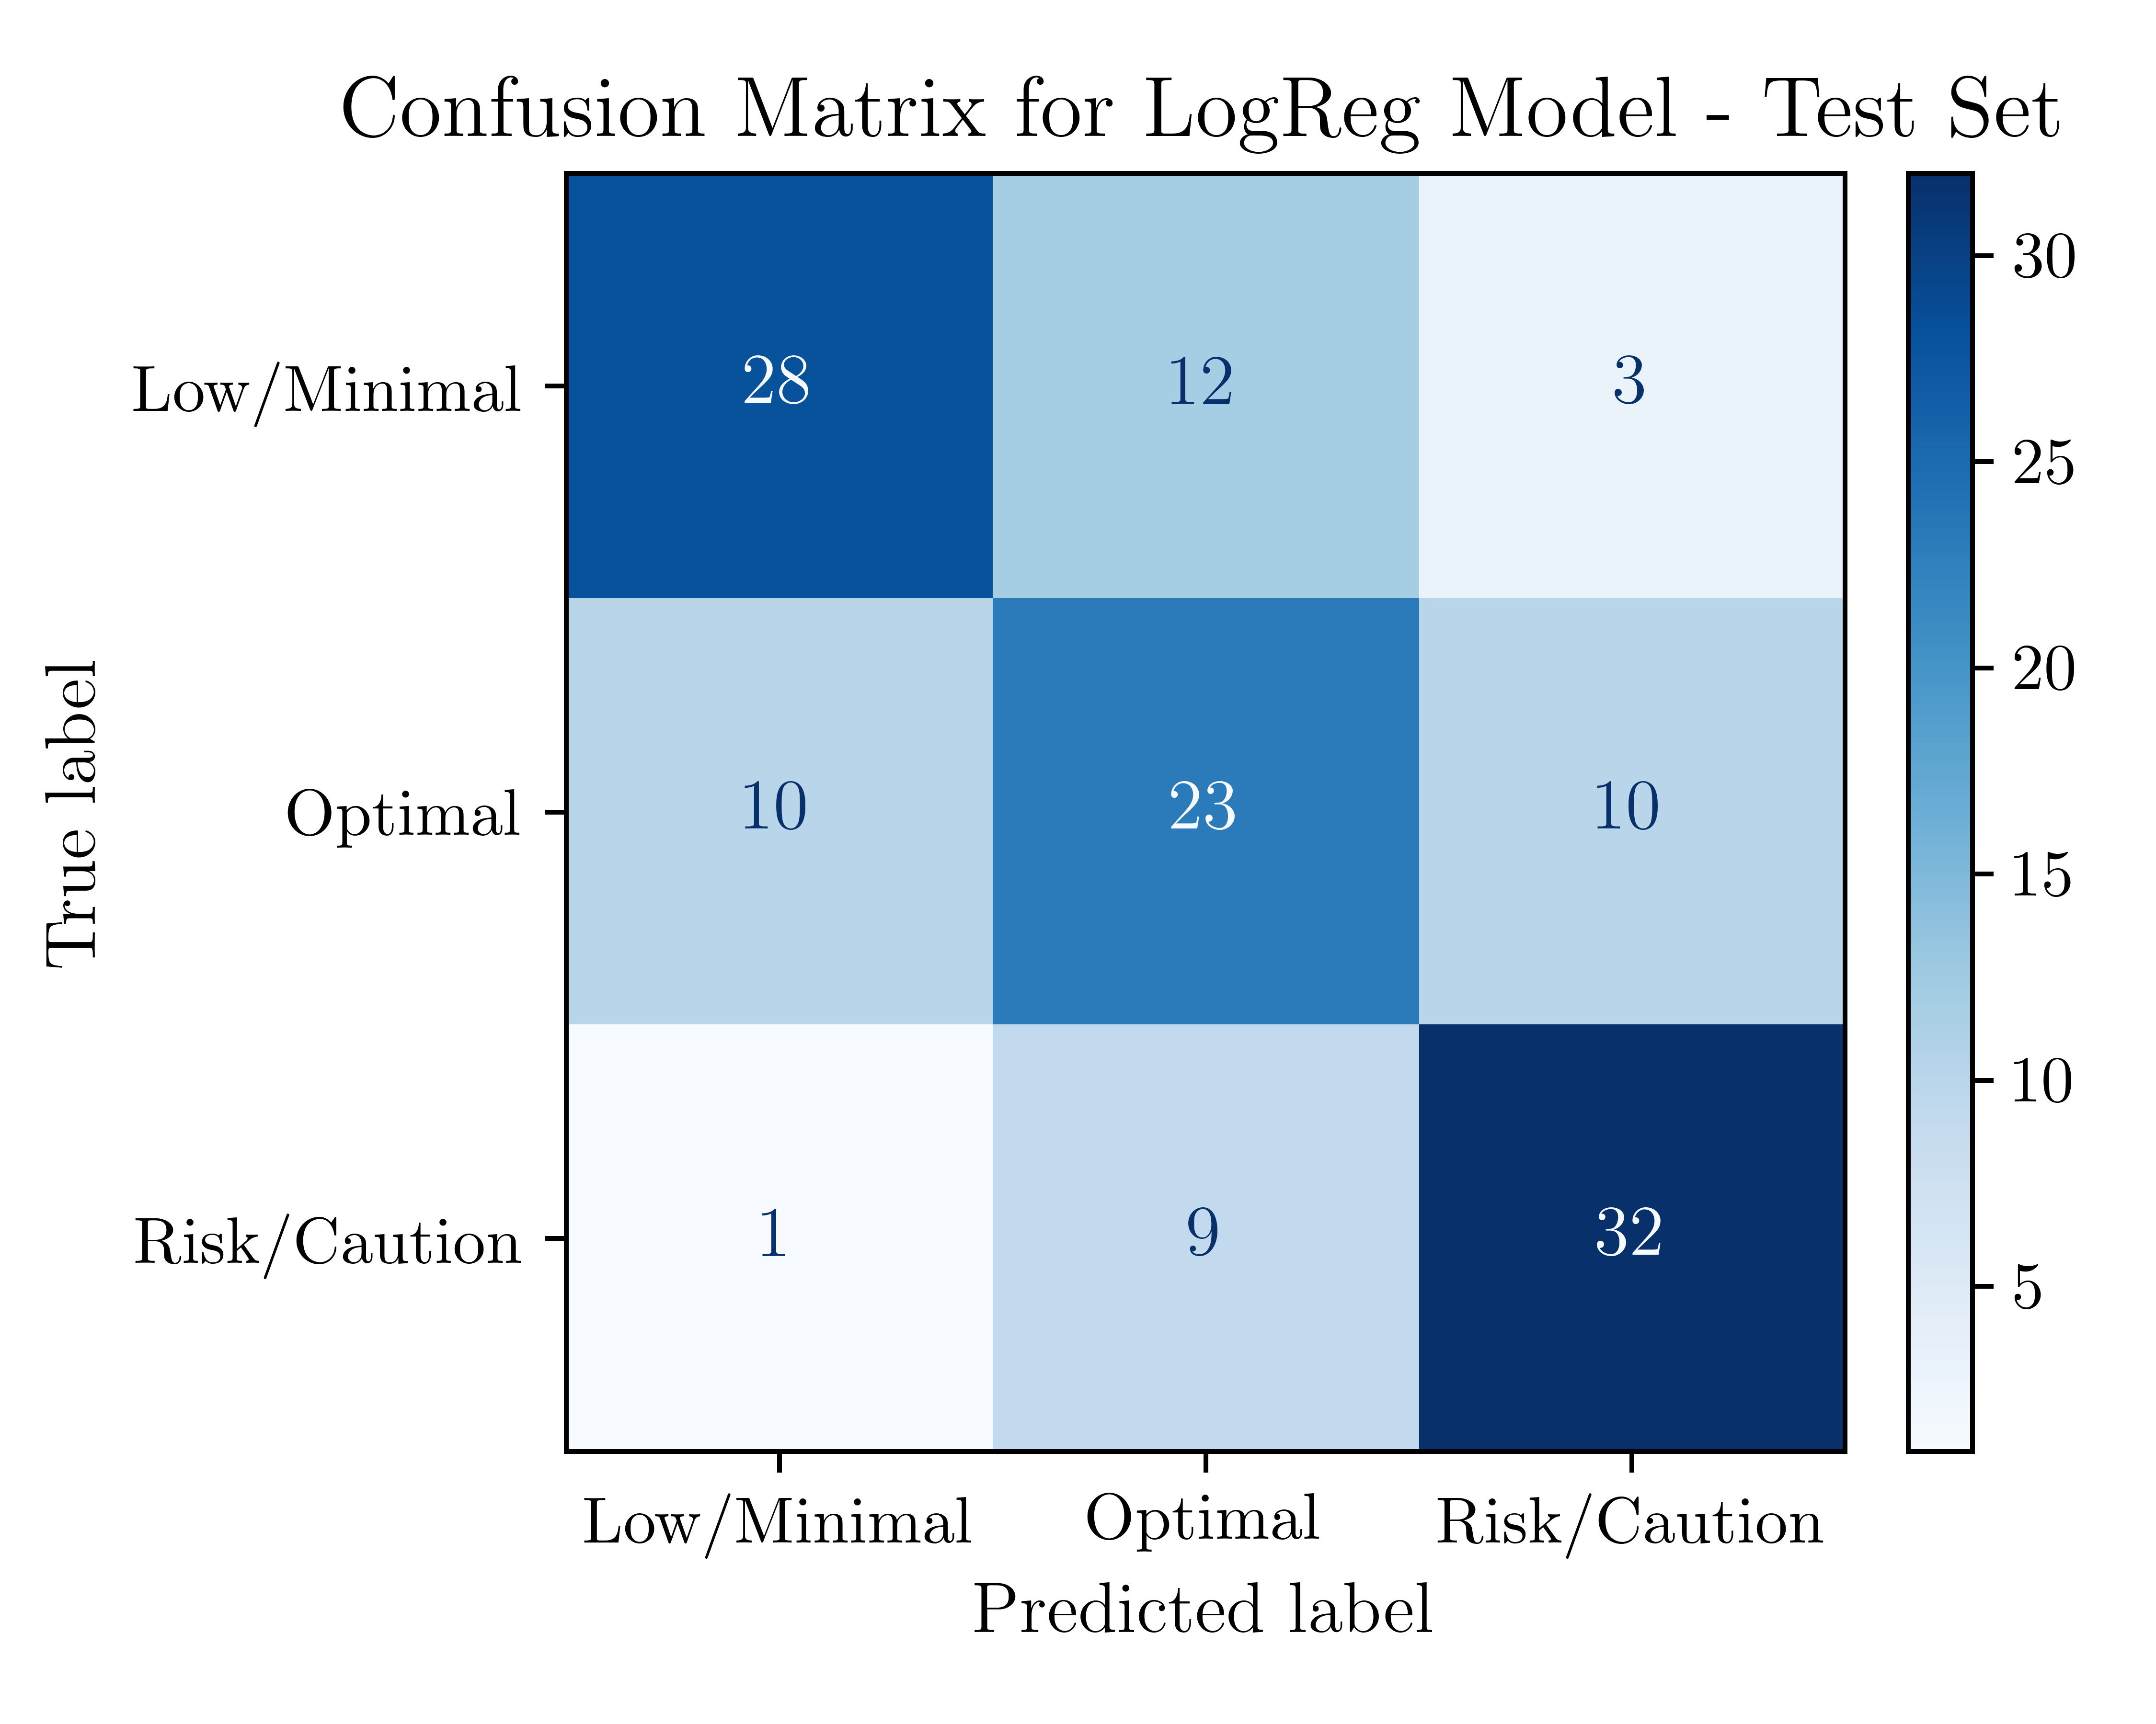
LOGISTIC REGRESSION

Slide 10
LOGISTIC REGRESSION

Slide 11
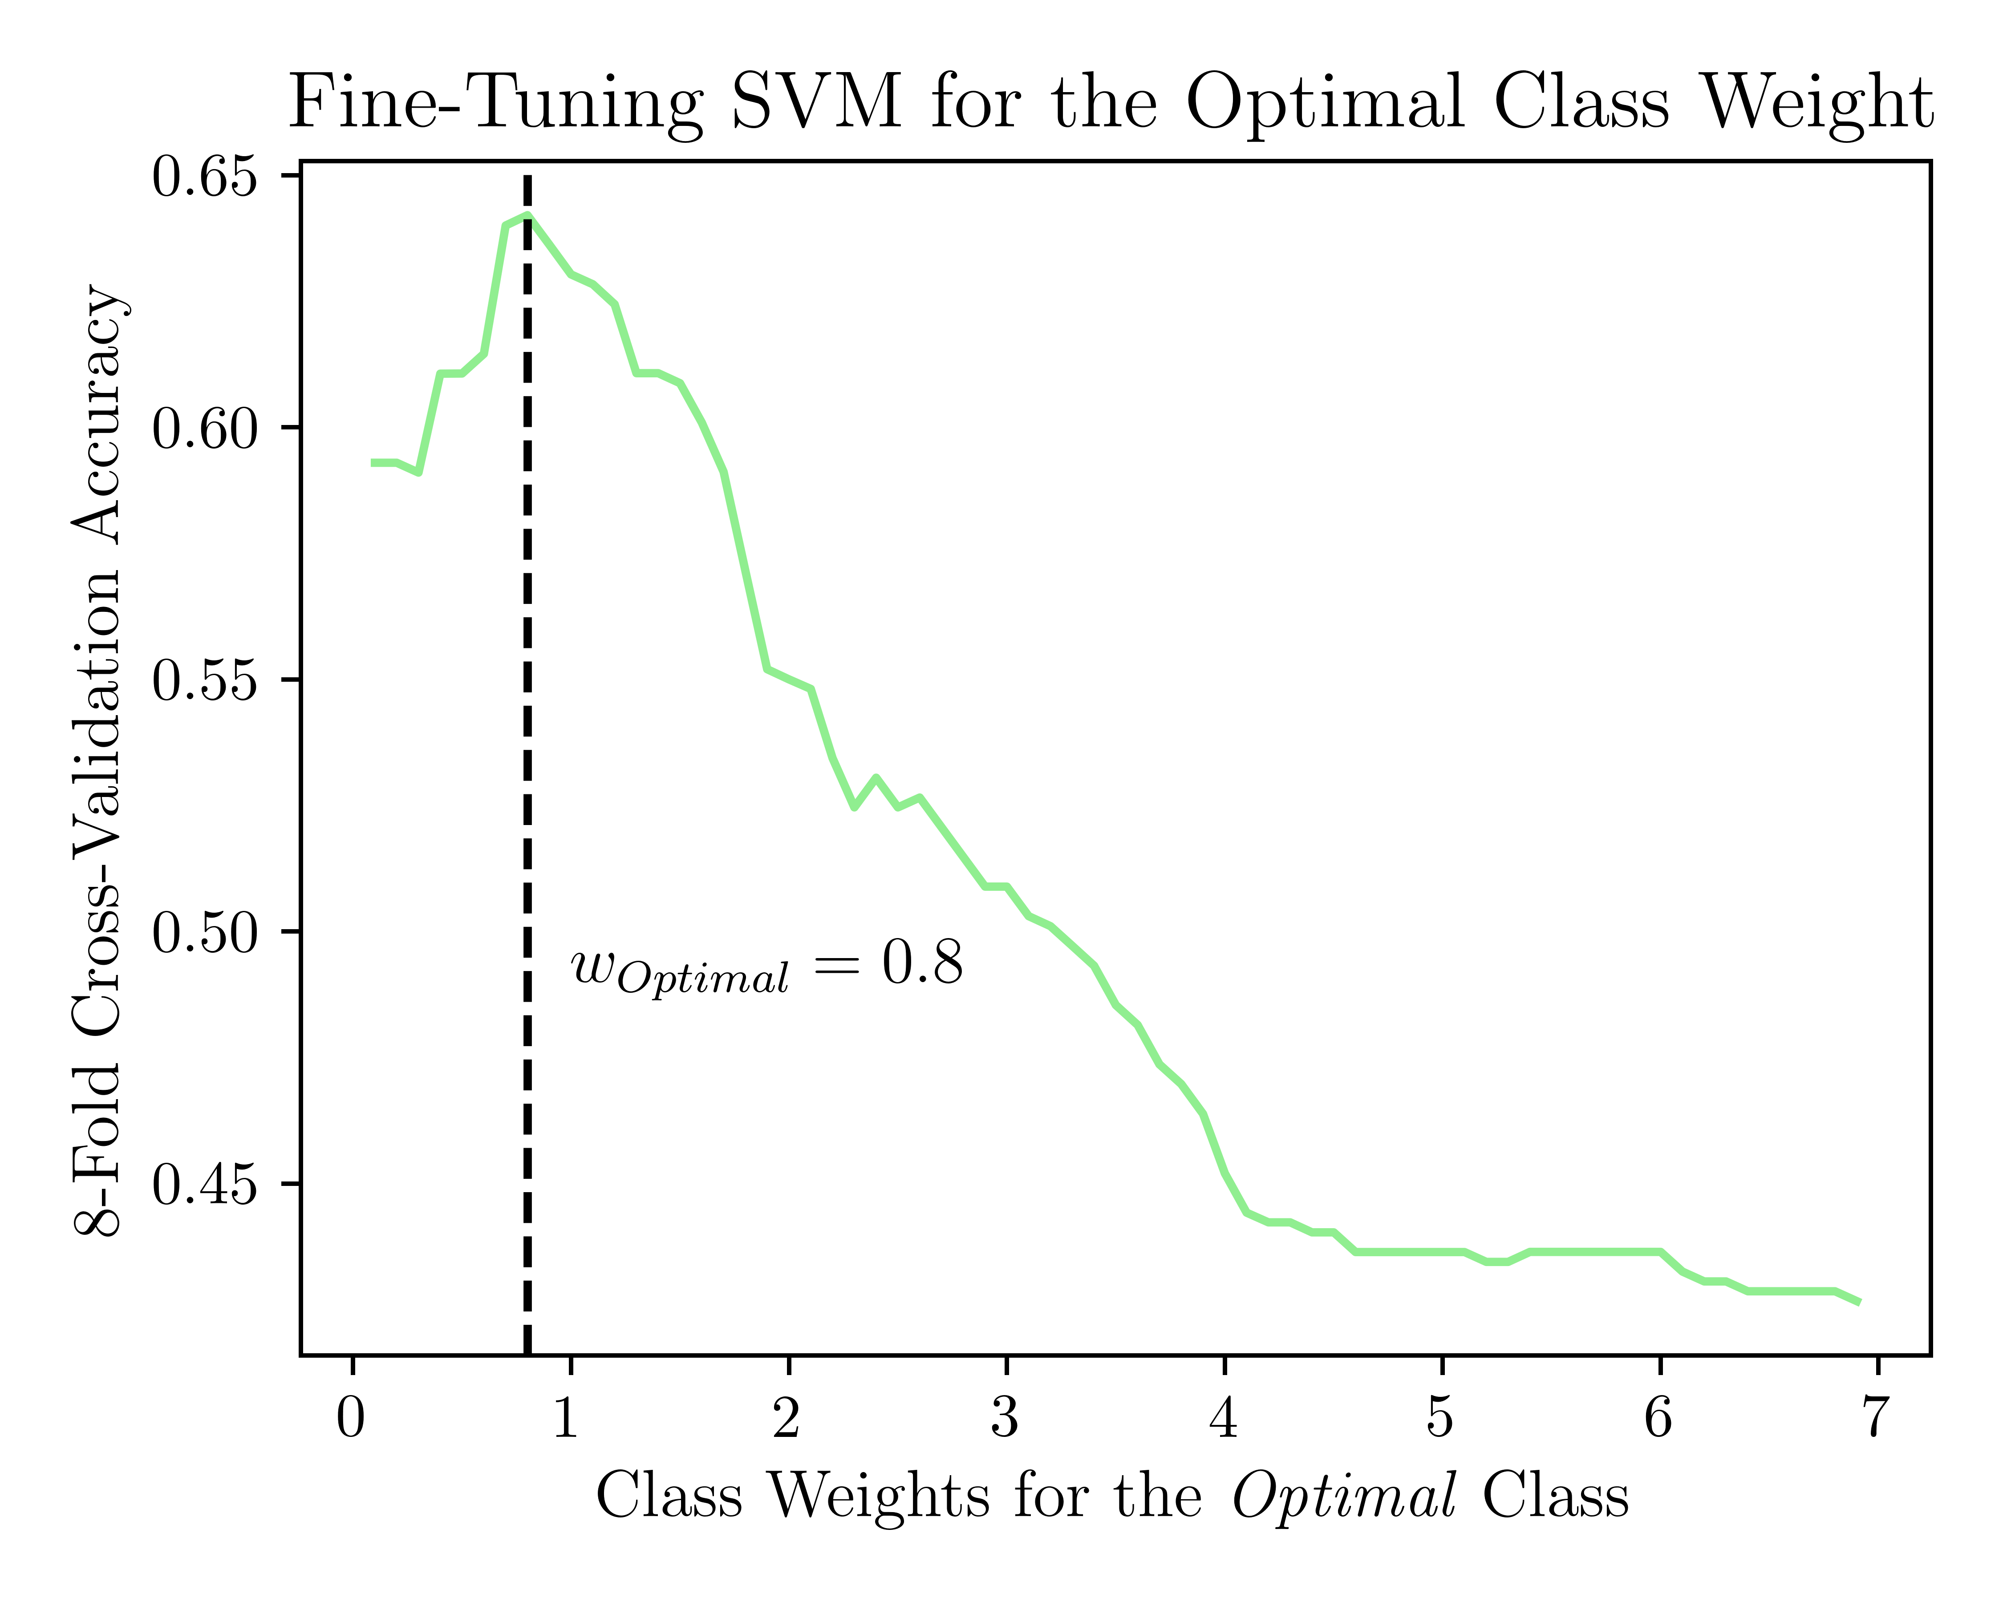
SUPPORT VECTOR MACHINE

Slide 12
SUPPORT VECTOR MACHINE

Slide 13
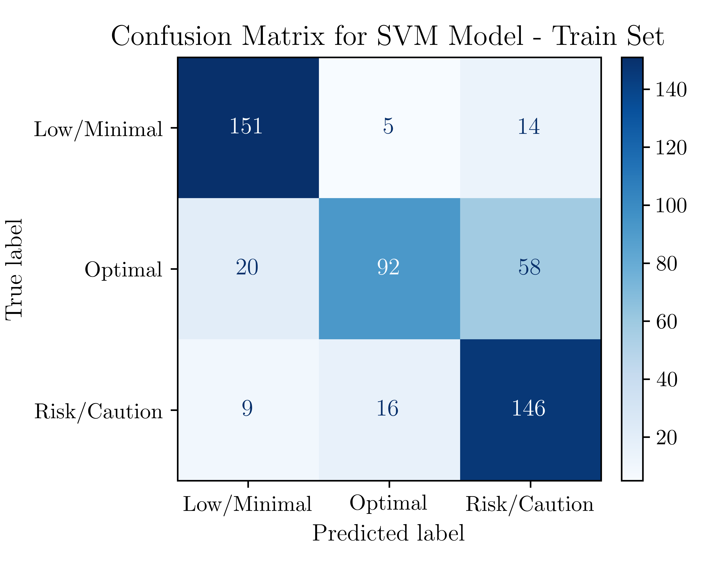
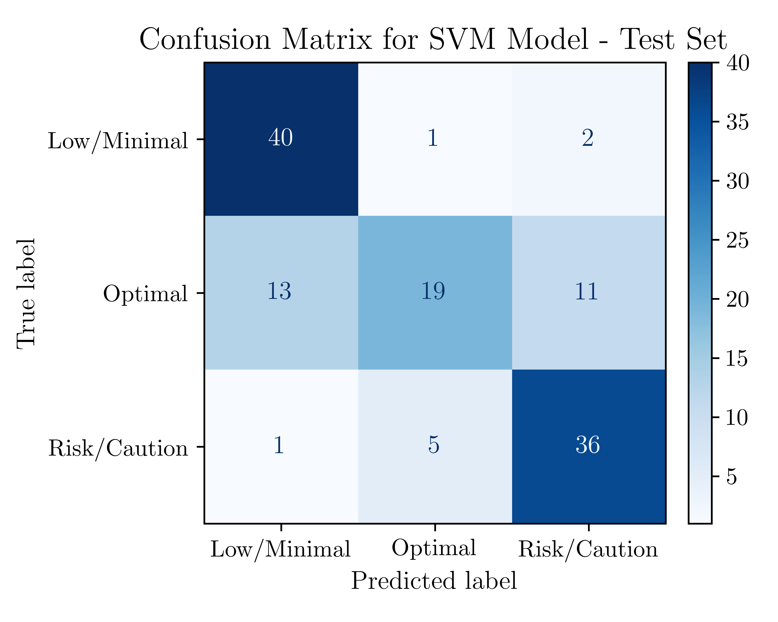
SUPPORT VECTOR MACHINE

Slide 14
SUPPORT VECTOR MACHINE

Slide 15
DECISION TREE MODEL

Slide 16
DECISION TREE MODEL

Slide 17
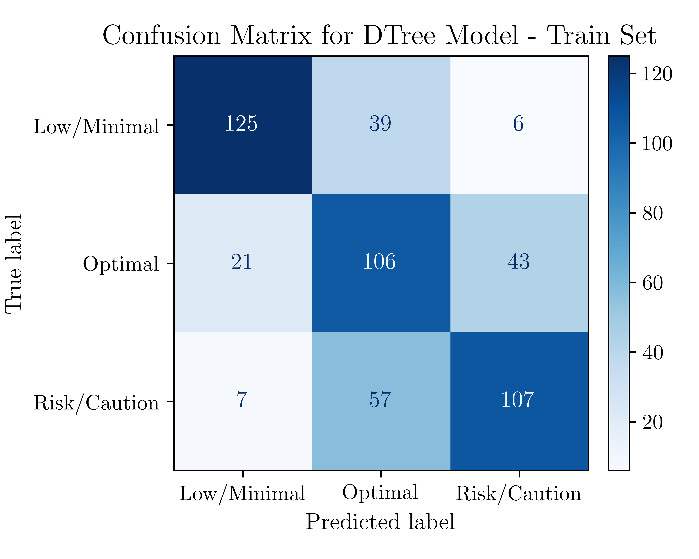
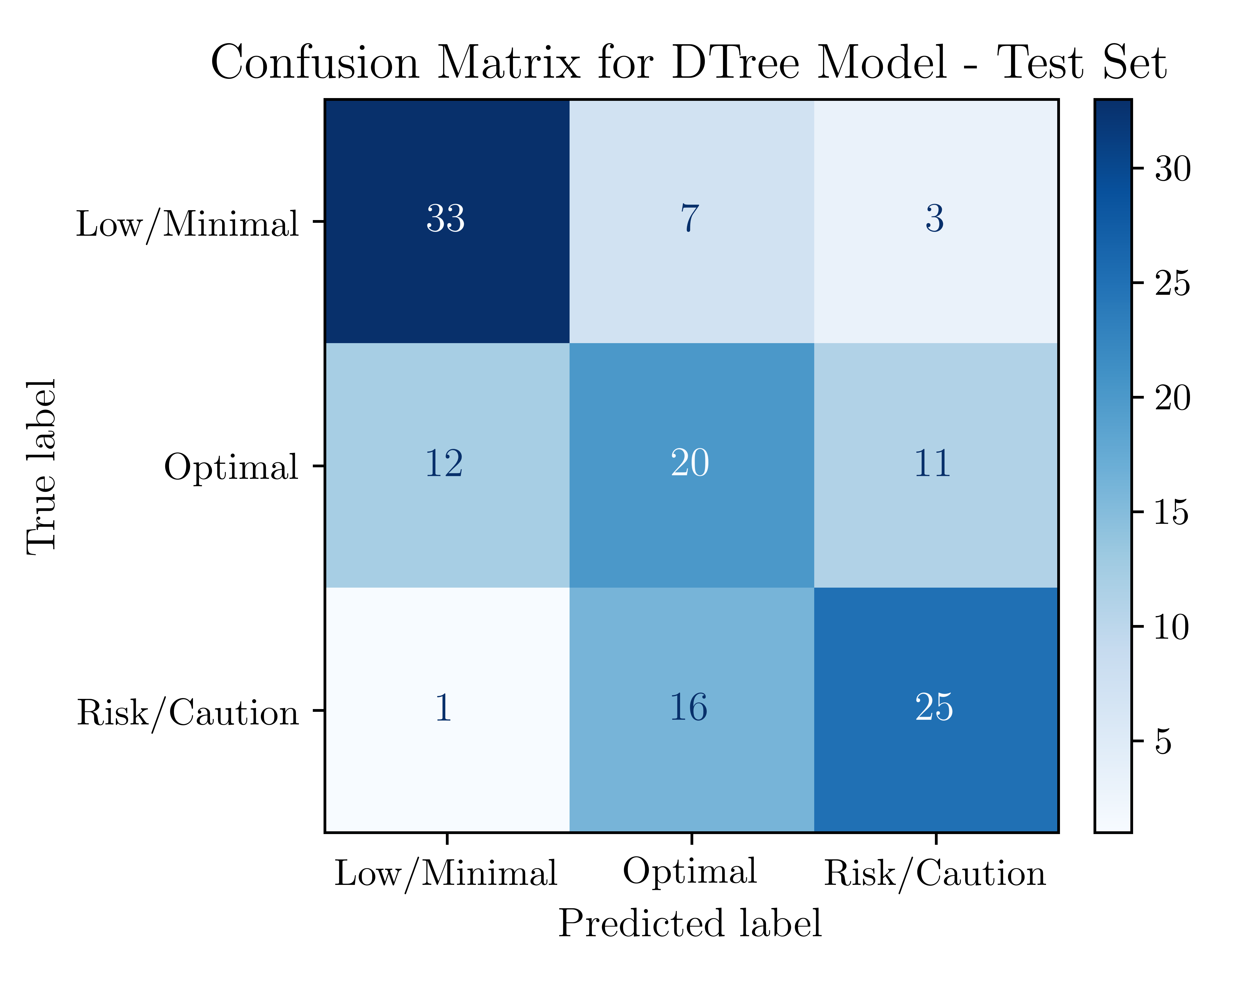
DECISION TREE MODEL

Slide 18
DECISION TREE MODEL

Slide 19
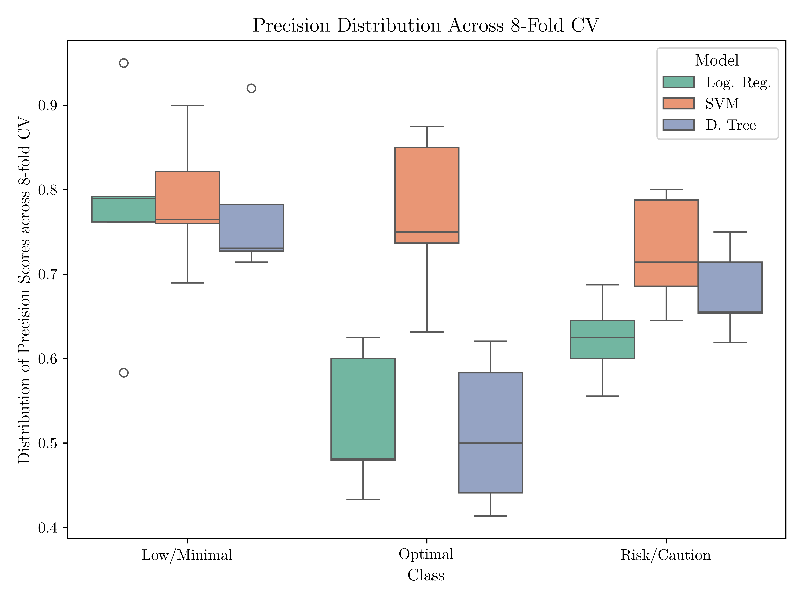
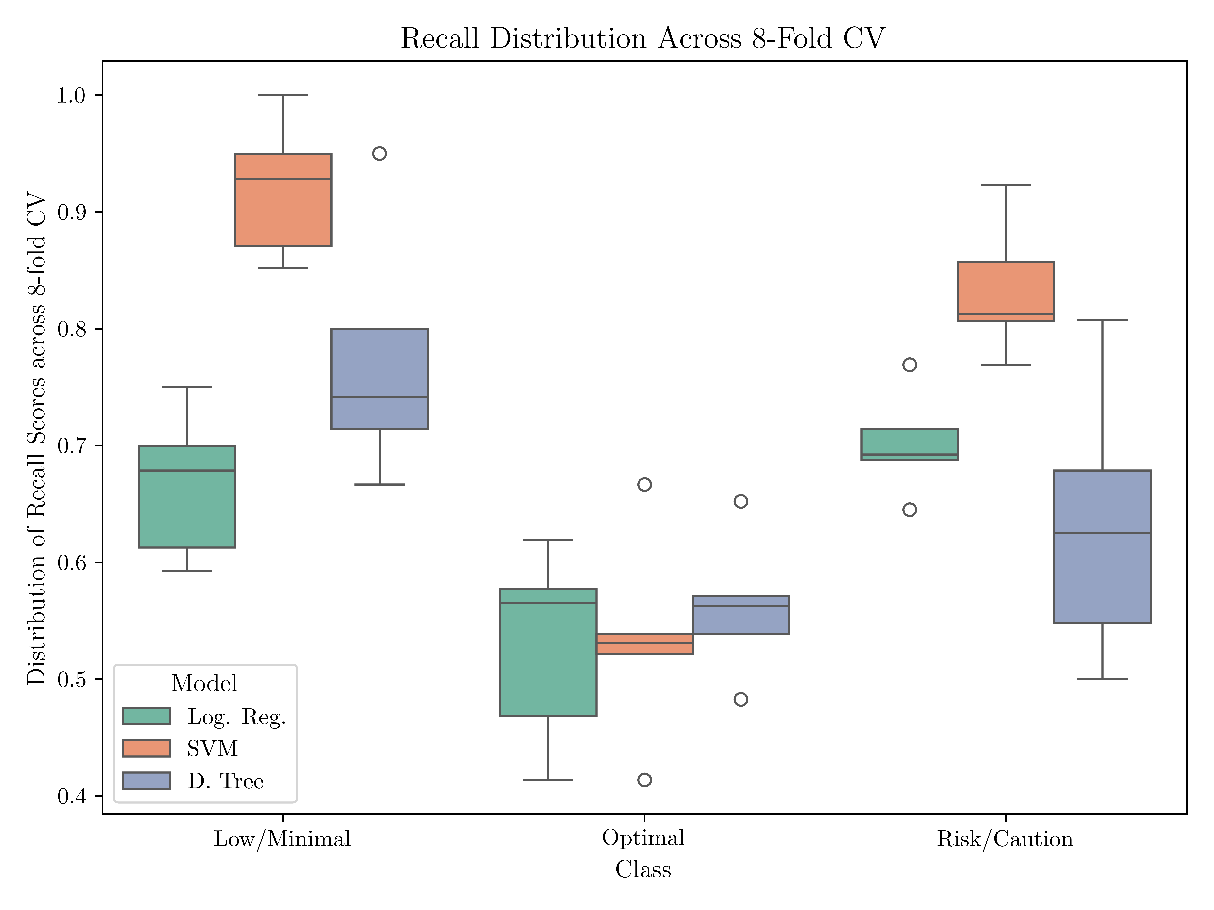
RESULTS

Slide 20
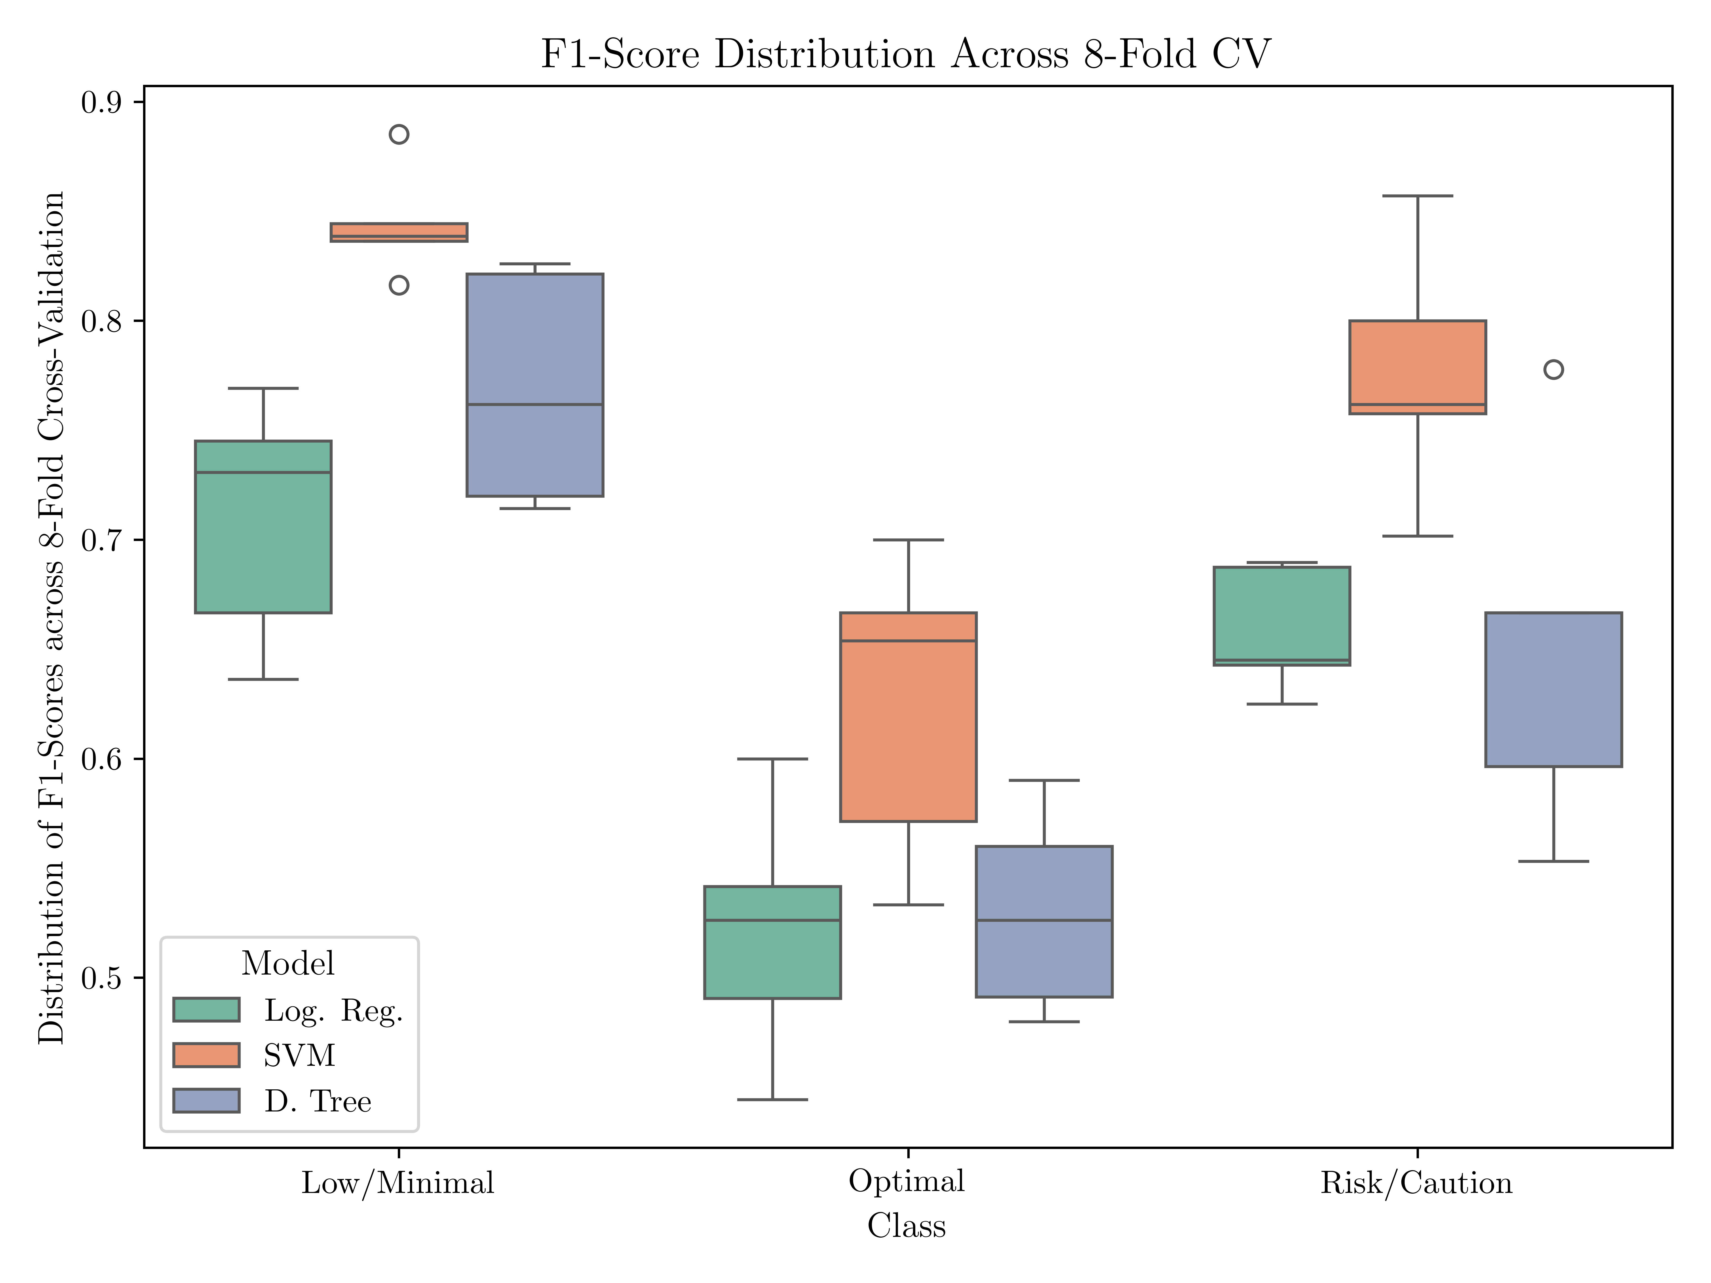
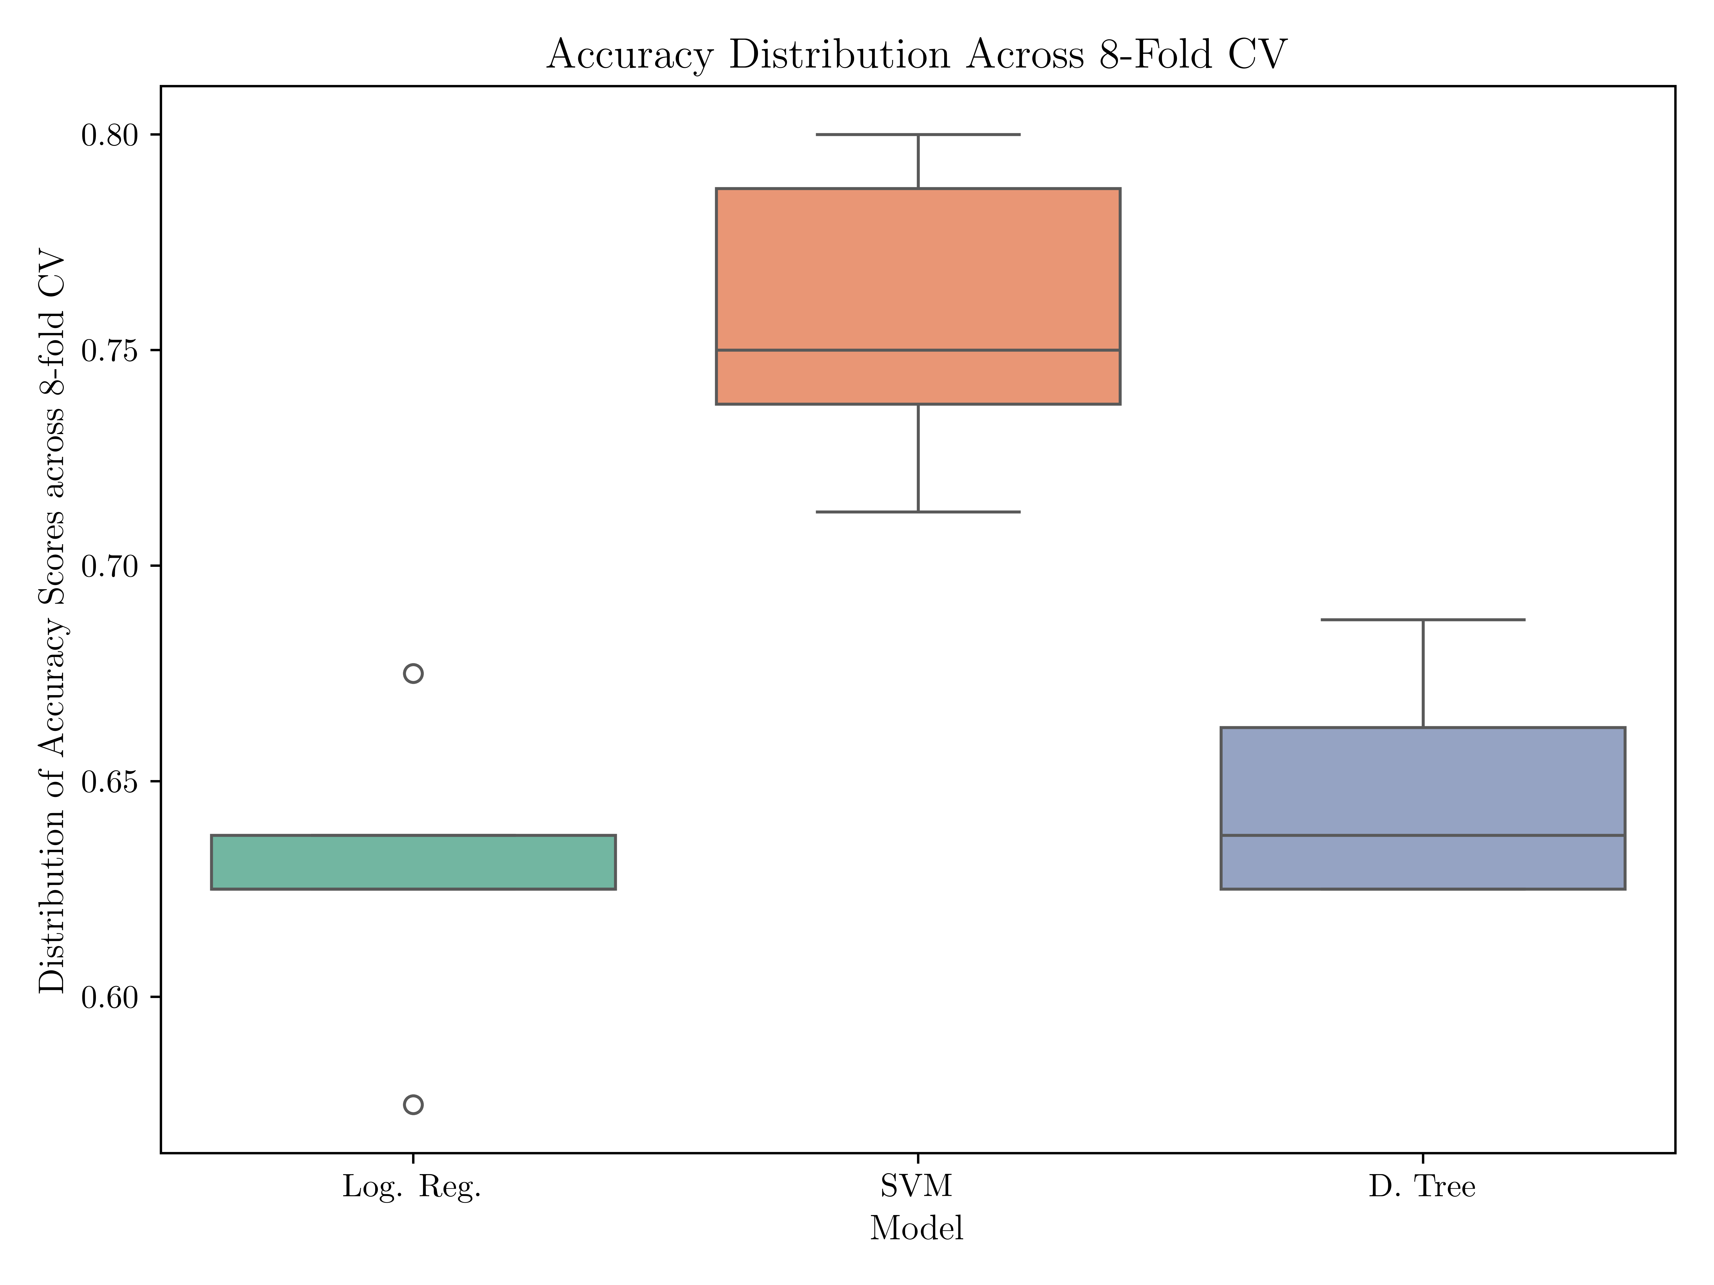
Results

Slide 21
results

